Slide 1
Scalable 5-Tuple Packet Classification in Overlay Network
Muhammad Arif
September 7, 2016
Notes:
Hello Good Morning
Thanks for coming
Today I will present about my thesis work with title

Slide 2
Agenda
Introduction
  Background
  Problem Statement
  Platforms Overview
Development
  5-Tuple LCAF & Mapping System
  Rule Aggregation
  Flow Classification
Result & Analysis
Conclusion and Future Works

Slide 3
Introduction

Slide 4
Introduction
Traditional Networking
Destination-based Forwarding
No global view, multiple control plane
OpenFlow
Up to 38 packet header fields
(SDN) Has global view, centralized control plane
Problems: Number of rules increases and rule size increases
  processing latency increases
  storage space requirement also increases
Notes:
Kasi panah

Slide 5
Problem Statement
Flexibility
Performance
SDN
5-Tuple
TN
Trade-off between flexibility vs performance: 5-tuple
Objectives:
  Propose rule aggregation algorithm to minimize number of entries stored → reduce the storage space requirement
  Propose flow classification method to minimize the lookup time → reduce processing latency
Notes:
Kasi gambar 5-tuple

Slide 6
Related Works
Packet Classification: Well-known topic for research
Decision-tree based:
  Well-known approach, such as in HiCut and HyperCut
  Cons: Tree size grows significantly due to finer TE
TCAM-based:
  Fast lookup process
  Cons: high implementation cost
Tuple Space Search (TSS):
  Very flexible
  Cons: high processing latency for high number of rules
Main Idea: MC-SBC
  Modified TSS
  Send rules and packets to specific smaller lookup tables
Notes:
TCAM: Specialized memory for fast lookup
MC-SBC: multidimensional-cutting via selective bit-concatenation

Slide 7
Platform Overview

Slide 8
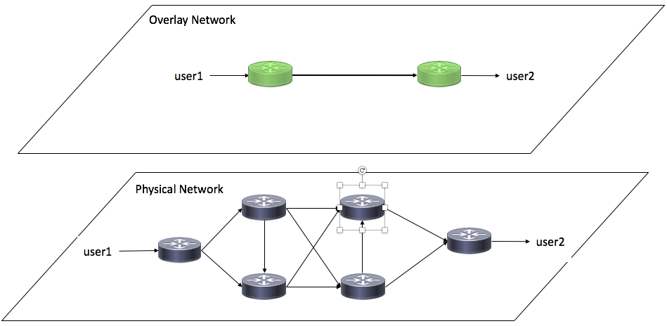
Open Overlay Router (OOR)
Overlay network is one of the well-known implementation of SDN
OOR: Open-source platform to create programmable overlay network

Slide 9
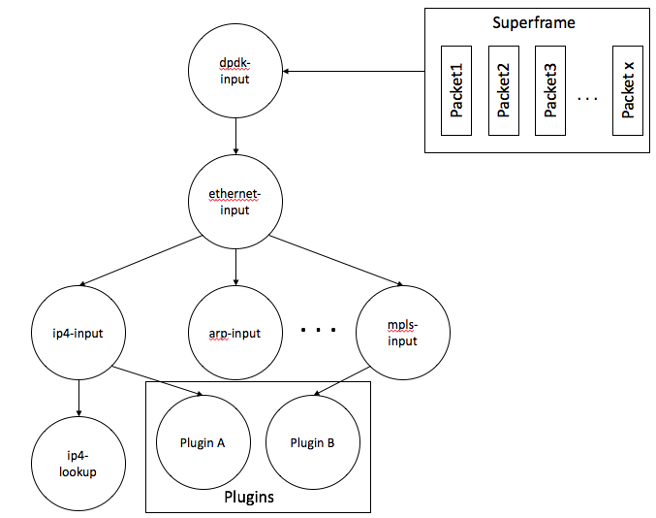
Vector Packet Processing (VPP)
High performance packet processing platform and runs entirely in the userspace
Process multiple packets in a time by building superframe
Packets are processed through Packet Processing Graph

Slide 10
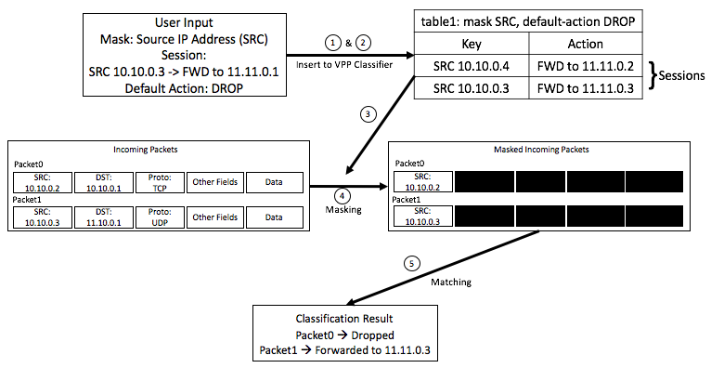
VPP Classifier
Using mask-and-match model
Two main parts: Tables and Sessions
Notes:
Salah iP

Slide 11
Developments

Slide 12
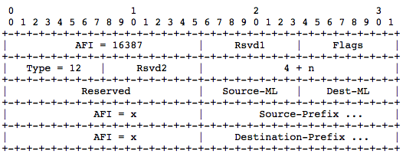
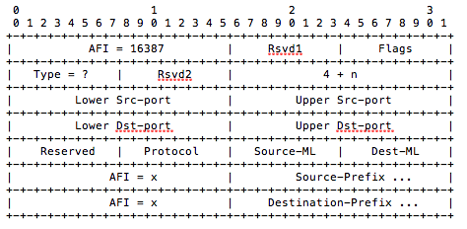
5-Tuple LCAF Implementation
2-Tuple LCAF (Current)
5-Tuple LCAF
Based on RFC Draft:
LISP support for Multi-Tuple EIDs

Slide 13
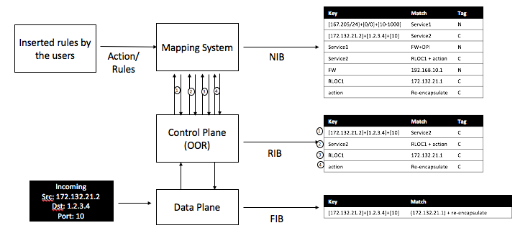
5-Tuple Mapping System
Goals:
  Faster Lookup Times
  Reduce amount of Control Message
Three Layers of Information Bases:
  NIB: Whole TE Rules
  RIB: Subset of NIB
  FIB: Ready-to-use Info

Slide 14
5-Tuple Mapping System (Cont.)
Structure:
  Key: 5-Tuple Information
  Match: Destination RLOC and Action
  Tag: Copied/Not-Copied to next database (NIB→RIB→FIB)
    To be used during update/removal of rules

Slide 15
Rule Aggregation and Flow Classification
Developed based on VPP Classification method
Basic Ideas:
  Splitting rules into each header fields
  Limiting wildcard positions during aggregation
  Using Multiple Tables for classification

Slide 16
Rule Aggregation
VPP classifier does not accept variable-sized header (wildcards) mask
Goals:
  Minimize the number of entries
  Give flexibility to use wildcards (predicted)
Predicted vs Free Wildcard Positions (4 bits rules)
Predicted | Free Wildcard Positions
1111 | 1111 | 0111 | 1010 | 0010
0111 | 1110 | 1100 | 0101 | 0100
0011 | 1101 | 1001 | 0110 | 1000
0001 | 1011 | 0011 | 0001

Slide 17
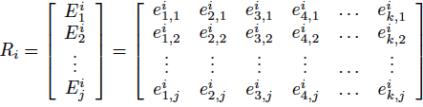
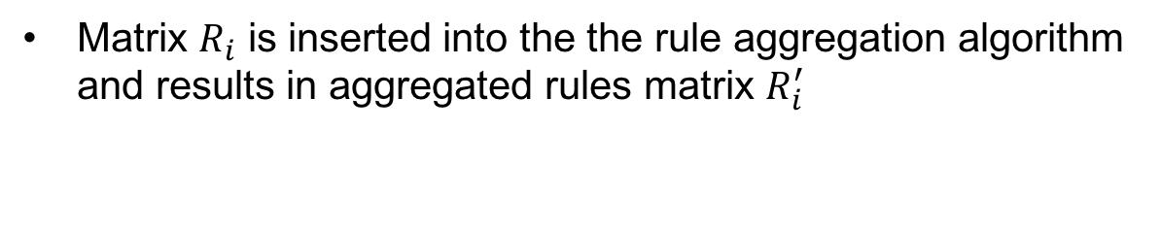
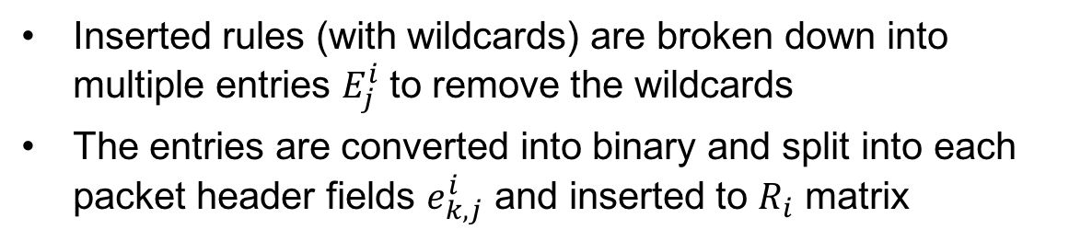
Rule Aggregation (Cont.)
Inserted rules (with wildcards) are broken down into multiple entries $E_{j}^{i}$ to remove the wildcards
The entries are converted into binary and split into each packet header fields $e_{k,j}^{i}$ and inserted to $R_{i}$ matrix
Matrix $R_{i}$ is inserted into the the rule aggregation algorithm and results in aggregated rules matrix $R_{i}^{′}$

Slide 18
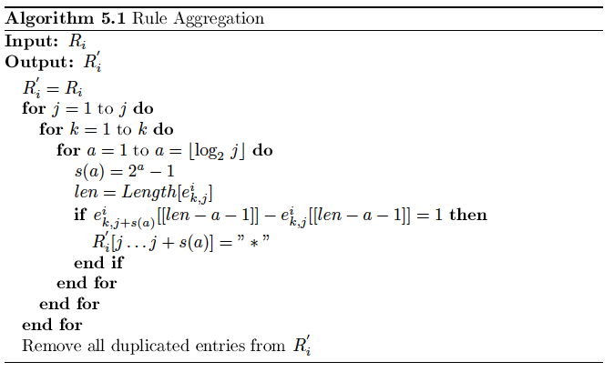
Rule Aggregation (Cont.)

Slide 19
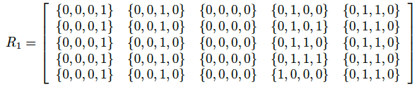
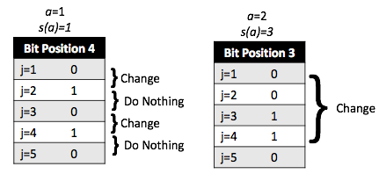

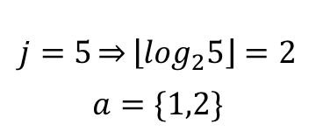
Rule Aggregation (Cont.)
Fields | Value | Binary* | Size
SRC Addr | 172.205.10.1 | {0,0,0,1} | 32 bits
DST Addr | 245.206.13.2 | {0,0,1,0} | 32 bits
SRC Port | 80 | {0,0,0,0} | 16 bits
DST Port | 20-24 | {0,1,0,0} {0,1,0,1} {0,1,1,0} {0,1,1,1} {1,0,0,0} | 16 bits
Protocol | TCP (6) | {0,1,1,0} | 8 bits
$$j=5\overset{⇒}{}\left\lfloor \log_{2}5\right\rfloor =2$$
$$a=\{1,2\}$$
Notes:
Sikat semua

Slide 20
Rule Aggregation (Cont.)
Fields | Value | Binary* | Size
SRC Addr | 172.205.10.1 | {0,0,0,1} | 32 bits
DST Addr | 245.206.13.2 | {0,0,1,0} | 32 bits
SRC Port | 80 | {0,0,0,0} | 16 bits
DST Port | 20-24 | {0,1,0,0} {0,1,0,1} {0,1,1,0} {0,1,1,1} {1,0,0,0} | 16 bits
Protocol | TCP (6) | {0,1,1,0} | 8 bits
Notes:
Sikat semua

Slide 21
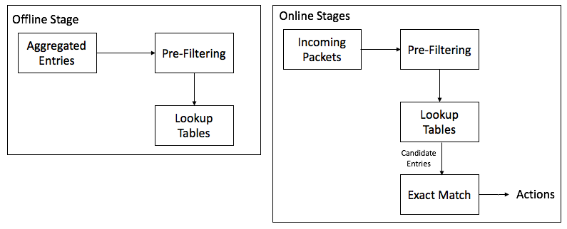
Flow Classification
Goal: reduce the lookup times
Similar to Tuple Space Search method, but based on specific bit position
Process: Offline and Online Stages
Pre-filtering: select one or more bit positions to split the rules into smaller multiple lookup tables as even as possible

Slide 22
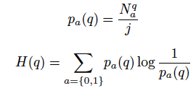
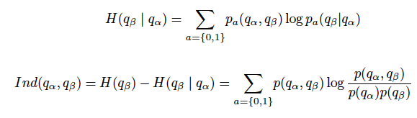
Flow Classification (Cont.)
Bit positions selected for the pre-filtering → Effective Bit Position (EBP)
To determine EBP:
  Diversity Index: to find most even distribution of zeros and ones
  Independence Index (for >1 EBP): to find bit positions that draws good distinction between entries

Slide 23
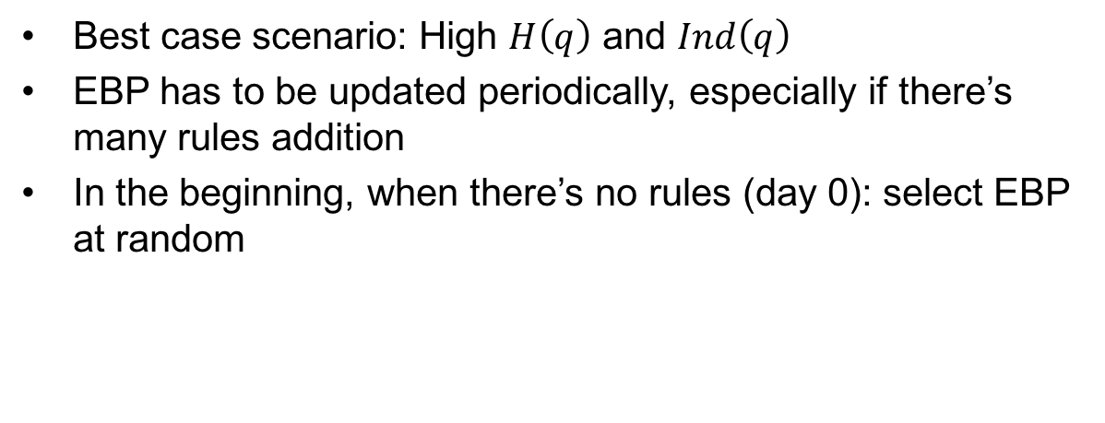
Flow Classification (Cont.)
Best case scenario: High $H\left(q\right)$ and $Ind\left(q\right)$
EBP has to be updated periodically, especially if there’s many rules addition
In the beginning, when there’s no rules (day 0): select EBP at random

Slide 24
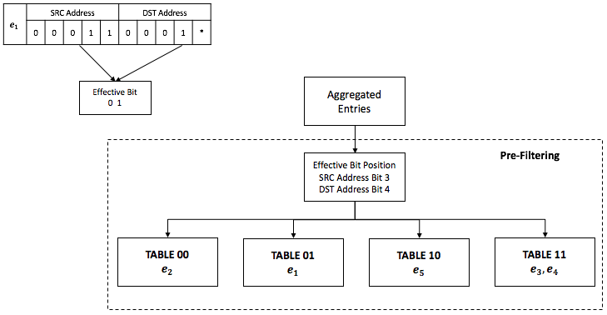
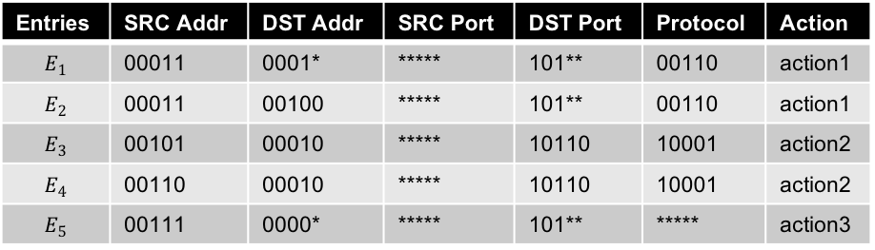
Flow Classification (Cont.)
Entries | SRC Addr | DST Addr | SRC Port | DST Port | Protocol | Action
$$E_{1}$$ | 00011 | 0001* | ***** | 101** | 00110 | action1
$$E_{2}$$ | 00011 | 00100 | ***** | 101** | 00110 | action1
$$E_{3}$$ | 00101 | 00010 | ***** | 10110 | 10001 | action2
$$E_{4}$$ | 00110 | 00010 | ***** | 10110 | 10001 | action2
$$E_{5}$$ | 00111 | 0000* | ***** | 101** | ***** | action3
Offline Stage

Slide 25
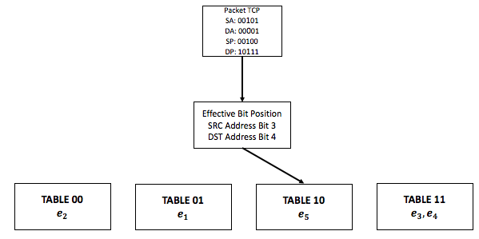
Flow Classification (Cont.)
Entries | SRC Addr | DST Addr | SRC Port | DST Port | Protocol | Action
$$E_{1}$$ | 00011 | 0001* | ***** | 101** | 00110 | action1
$$E_{2}$$ | 00011 | 00100 | ***** | 101** | 00110 | action1
$$E_{3}$$ | 00101 | 00010 | ***** | 10110 | 10001 | action2
$$E_{4}$$ | 00110 | 00010 | ***** | 10110 | 10001 | action2
$$E_{5}$$ | 00111 | 0000* | ***** | 101** | ***** | action3
Online Stage

Slide 26
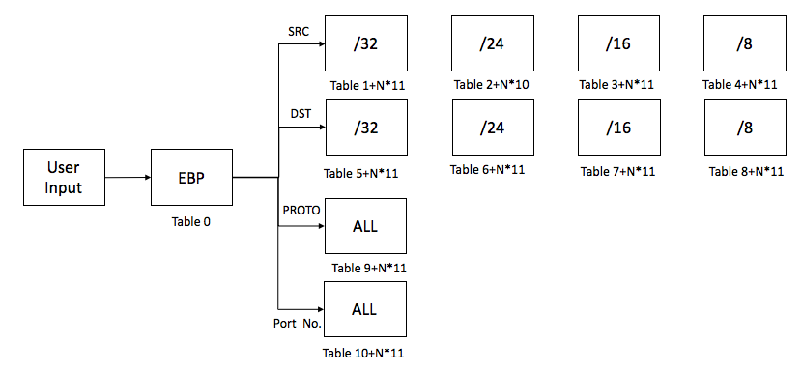
Implementation in VPP
Offline Stage

Slide 27
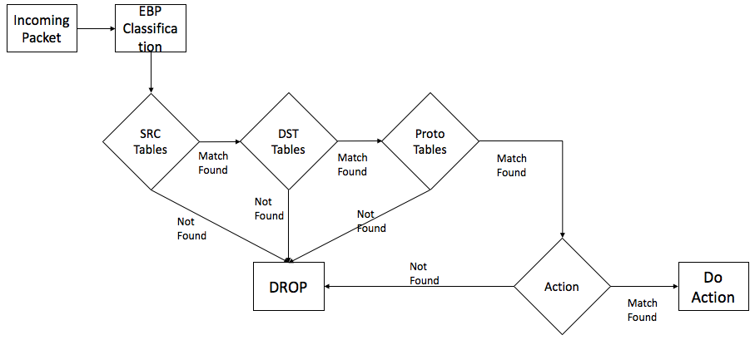
Implementation in VPP (Cont.)
Online Stage

Slide 28
Results & Analysis

Slide 29
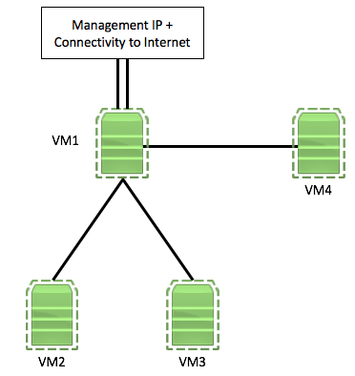
Simulation and Testing Setup
Testbed using VMs to implement OOR and VPP
Synthetic rules generator: Classbench
Packet generation: hping3
Name | Function
VM1 | VPP and Classbench
VM2 & VM3 | xTR and hping3
VM4 | MS and hping3

Slide 30
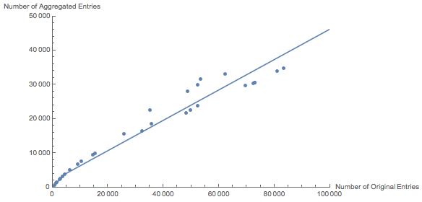
Result: Rule Aggregation
Original | Aggregated | %
1607 | 1419 | 94.5
8640 | 6573 | 76.0
31571 | 16357 | 51.8
74527 | 31321 | 42.02
84815 | 35367 | 41.7
Number of stored entries can be reduced
Minimum achievable aggregation: 41.4%
Higher number of original rules lead to more aggregation

Slide 31
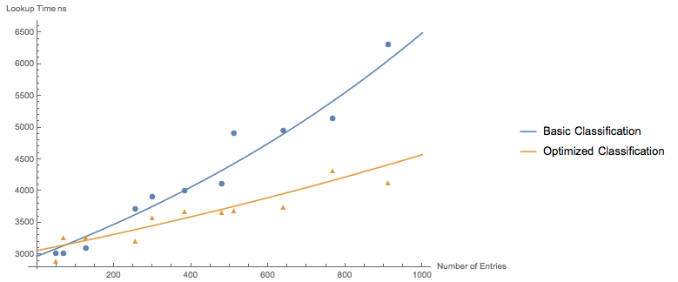
Result: Flow Classification
Lookup times can be reduced
After 76 entries, the performance of proposed method surpassed the basic method
Maximum achievable reduction: 29.6%

Slide 32
Conclusions

Slide 33
Conclusions
SDN provides flexibility and programmability, but it comes with scalability problem
Implementation of proposed 5-tuple rule aggregation and flow classification are able to reduce:
  Number of entries stored → less storage space requirement
  Lookup times → lower processing latency
In the testing phase, we found:
  58.6% savings in storage space requirement
  29.6% reduction in processing latency

Slide 34
Future Works
Extend the proposed rule aggregation
  To check for overlapping rules
  To find faster way for calculation
Extend the flow classification method
  Calculate and Update EBP in real time
  Other method to determine EBP
To check the effectiveness of the proposed methods in the real and big network

Slide 35
Thank You!

Slide 36
Introduction
Traditional networking: destination-based forwarding
  Only consider single header field → scalable but not flexible
  No global view of the network → programmability problem for complex TE rules
Software-Defined Networking:
  Flexible → up to 38 packet header fields can be observed
  Has global view of the network → centralized control plane → easy to program
Problem: requirement for more specific traffic engineering rules → rule size increases
  processing latency increases
  storage space requirement also increases

Slide 37
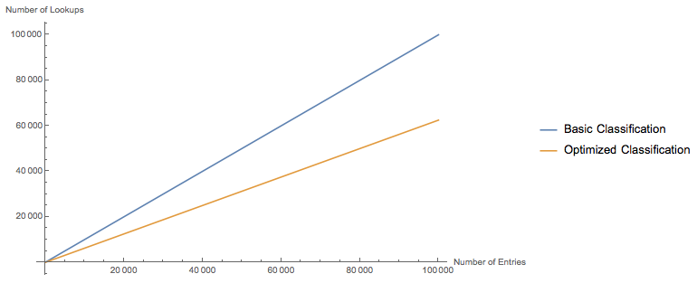
Result: Flow Classification
Number of entries to be checked can be minimized
In average only 56.9% of entries that needs to be checked
Reason: multiple lookup tables

